Slide 1
EViews Training
EViews Programming

Slide 2
The EViews Command Language

Slide 3
The EViews Command Language
The EViews command language may be split into four groups:
Commands
Functions
Object Views and Procs
Object Data Members

Slide 4
EViews Commands
EViews commands tell EViews to:
Manipulate object containers (Workfiles, Pages, Databases).
Create new objects.
Show, copy, delete, rename or close objects.
Set Program options.
A list of all EViews commands can be found in Chapter 12 of the EViews 9 Command and Programming Reference (PDF available from the EViews Help Menu).

Slide 5
EViews Commands: Container Manipulation
The most common type of EViews commands are those that create, open, or interact with EViews workfiles.
In general these commands start with "wf":
wfopen – open an existing workfile on disk, or a foreign file.
wfcreate – create a new workfile.
wfclose – close a workfile.
wfsave – save the current workfile as an EViews file or a foreign format.
wfselect – change the current active workfile.
wfrefresh – refresh the links in the current workfile.

Slide 6
EViews Commands: Container Manipulation
Commands that manipulate pages generally start with "page":
pageload – load a new page in the current workfile.
pagecreate – create a new page in the current workfile.
pagedelete – delete a page in the current workfile.
pageselect – change the current active workfile page.
pagestruct – restructure the current page.
pagerename – rename a page in the current workfile.

Slide 7
EViews Commands: Container Manipulation
Similarly, commands that work on databases start with "db".
Other object container commands include:
smpl – change the sample of the current workfile page.
import – import data into the current workfile page.
fetch – fetch data from a database into the current workfile page.
store – store data from the current workfile page into a database.

Slide 8
EViews Commands: Object Creation
Object creation commands (often called object declaration commands) are used to create new objects in the current workfile. The commands are, generally, simply the type of object, followed by the name of the new object:
series x – create a new series called "X".
equation eq1 – create a new equation called "EQ1".
group g – create a new group called "G".

Slide 9
EViews Commands: Object Creation
Often you can follow the command with further specification for the object:
series x = @nrnd – create a new series called "X" filled with normal random numbers.
group g x y z – create a new group called "G" containing the series "X", "Y" and "Z".
The full syntax for each object's declaration command can be found at the start of each object's section of Chapter 1. of the EViews 8 Object Reference.

Slide 10
EViews Commands: Object show/copy/rename/delete/close
The following commands work on workfile objects
show – display a view of an object.
freeze – freeze the view of an object into a new object.
copy – copy the object from workfile to workfile, or page to page, or create a copy in the current page.
rename – rename an object.
delete – delete an object.
close – close an object (if it object is currently being shown).

Slide 11
EViews Functions
EViews functions are used to assign values to Series or Alpha objects, or Matrix and Scalar objects, or program variables.
Functions generally start with an "@" symbol, and are preceded by an object name (and, possibly declaration) and an "=". For example:
series x = @nrnd
Here the @nrnd function is used to assign standard normal random numbers to the series X.
A list of all EViews functions can be found in Chapter 14 of the EViews 9 Command and Programming Reference. Full details of the functions can be found in Chapter 13.

Slide 12
EViews Functions
There are many types of EViews functions:
Basic mathematical Time series Financial Descriptive Statistics Cumulative Statistics Moving Statistics Group Row | By-Group Trigonometric Statistical Distribution String Date Indicator Workfile & Information

Slide 13
EViews Functions
Some examples:
series x = @log(y) series x = @pch(y) series x = @pv(r,n,y) scalar x = @mean(y) series x = @cumsum(y) series x = @movav(y,3) series x = @rsum(g) series x = @minsby(y,s) !x = @tan(y) scalar x = @cnorm(y) !x = @instr(%y, "he") string x = @strnow series x = @trend | Create a series, X, and assign the values of log(Y) to it. Assign the one-period percentage change in Y to X. Present value of Y, given a rate of R and N periods. Create a scalar, X, equal to the mean of Y. Cumulative sum of Y. Three period moving average of Y. Row-sum of the group, G. Minimum values of Y for each category of S. Assign the tangent of the program variable !y to !x. Cumulative normal distribution at value Y. Find the position of the phrase "he" in the string %y. Create a string object containing the current date/time. Create a trend series.

Slide 14
Object Views and Procs
The EViews workfile is a collection of objects. Each object type has different Views and Procs available to it, and they are generally accessed by clicking on either the View menu or the Proc menu when an object is open.
Each object view and proc has a command line equivalent. The general syntax of object views and procs is:
object.view(options) arguments
i.e. the name of the workfile object, followed by a dot, then the view/proc name, followed by options and any arguments.
The Views and Procs available to each object type are listed in the EViews 9 Object Reference.

Slide 15
Object Views and Procs
Some examples:
show eq01.stats show gdp.line freeze(gr1) gdp.line eq01.forecast yf unemp.smooth unemps show gp.coint(s) | Show the regression output of the equation object EQ01. Show a line graph of the series GDP. Freeze the graph of GDP into a new graph object, GR1. Forecast EQ01, storing the forecast values into series YF. Exponential smoothing on UNEMP, and save to UNEMPS. Show the summary cointegration test results for group GP.

Slide 16
Object Data Members
Along with the Views and Procs available to each object type, objects also contain "data members". These are retrievable objects that contain information about the parent object.
Data members are only available via command. There is no mouse equivalent. The syntax for retrieving a data member is always:
=object.@member
Data members always return strings, scalars, or matrix objects. Note, they never return series or alpha objects.

Slide 17
Object Data Members
Data members are stored with the object. EViews, in general, does not need to perform calculations to retrieve the members (unlike Views and Procs).
Each object's data members are listed at the start of the object's section of the EViews 9 Object Reference.

Slide 18
Object Data Members
Some examples:
=unemp.@displayname =gdp.@first scalar x = eq01.@r2 matrix x = eq01.@coefcov vector x = eq01.@tstats =g1.@count =g1.@seriesname(1) | Returns the UNEMP series' display name. Returns the date of the first non-NA in GDP. Stores the R-squared from EQ01 into the scalar X. Saves EQ01's coefficient covariance matrix into matrix X. Saves the t-statistics into vector X. Returns the number of series in the group G1. Returns the name of the first series in the group G1.

Slide 19
EViews Program Basics

Slide 20
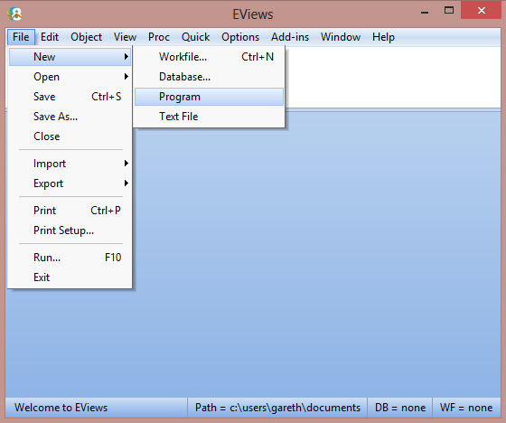
Creating a New Program
EViews programs are merely a collection EViews commands collected together in a text file named with a .prg extension. As such any text editor can be used to create an EViews program.
However the easiest way to create one is to use EViews itself, by clicking on
File->New->Program.

Slide 21
Loading and Saving Programs
To open an existing program, simply click on File->Open->Program.
To save an open program, click on File->Save.

Slide 22
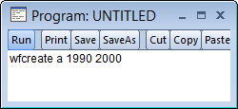
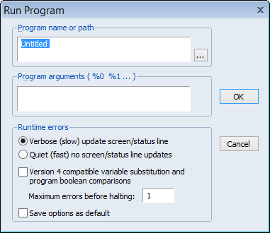
Running a Program
Once you have created your program, you can run it by clicking on the Run button.
This brings up the Run dialog, which contains some program execution options. We’ll ignore those for now, and just hit the OK button.

Slide 23
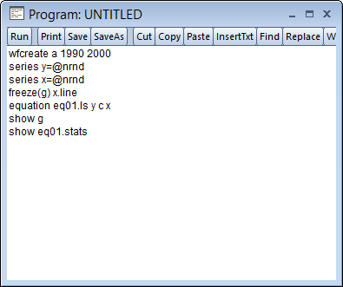
A Simple Program
The simplest program is just a collection of simple commands:

Slide 24
Program Comments
EViews uses the apostrophe as a comment character in programs. Any text following a ' and on the same line will be ignored by the program.
Example:
series x = @nrnd 'this is a comment
Only the "series x = @nrnd" part of this line is executed by EViews.

Slide 25
Program Variables

Slide 26
Program Variables
Program variables are variables that only exist when the program is running. Once the program has finished, the variables disappear. They do not form part of your workfile.
There are two types of program variables. Numeric and string variables. Numeric variables start with an “!”. String variables start with a “%”.
Tip: Due to their temporary nature, displaying program variables is difficult. For debugging purposes it is often useful to temporarily assign program variables to workfile objects (such as scalars, strings or tables) to help you follow what is happening to your program variables.

Slide 27
! Variables
! variables are numeric scalar program variables. They can be used in most mathematical calculations in a program.
Examples:
!x = 3
!y = 3+2
!z = !x + !y
!pi = 4*@atan(1)
series y = @sqrt(!z)

Slide 28
% Variables
% variables are character/string program variables. They contain quoted text.
You can concatenate two strings with a + sign. You may also use string functions to assign to a % variable.
Examples:
%x = "hello"
%y = "my name is" + %name
%pi = "3.142"
%z = "The date/time is " + @strnow

Slide 29
Replacement Variables
You can use % variables in two ways. The first is as an string actual string – i.e. anywhere EViews expects a string value, you can use a % variable instead.
The second way is as a "replacement". Replacement variables are used to substitute the variable with its string value.
To instruct EViews to use a % variable as a replacement, rather than as a string, enclose the % variable inside braces {}.

Slide 30
Replacement Variables
Example:
%x = "gdp"
series y = %x
series z = {%x}
The first line assigns "gdp" to the % variable %x.
The second line is read by EViews as:
series y = "gdp"
This will error (series are numeric and cannot contain text).
The third line, however, is read by EViews as:
series z = gdp

Slide 31
Replacement Variables
A good rule of thumb to follow when deciding whether you should enclose your % variable inside braces or not, is to think "Does EViews expect quotes in this command?" If EViews is expecting quotes, leave the % variable as it is. If it is not expecting quotes, uses the braces.
series y = {%z} + {%z}
scalar p = @instr(%z, %y)
%z = "name"
alpha a = %z
alpha b = {%z}
Note the difference between the last two – the first sets A equal to "name", and the second sets B equal to the alpha series called NAME.

Slide 32
Program Arguments
Program arguments are special % string variables whose value may be changed every time you run the program. The individual arguments are called "%0", "%1", "%2" and so on.
You can set the arguments using the Run dialog:
Simply enter a space delimited list of values in the Program arguments box.

Slide 33
Program Arguments
For example, take the following program line:
equation eq1.ls {%0} C {%1}
If you enter "Y X" into the Program arguments box on the run dialog, then the program will execute the line:
equation eq1.ls Y C X
Whereas entering "GDP UNEMP" would execute:
equation eq1.ls GDP C UNEMP

Slide 34
Control of Execution

Slide 35
If/else/endif statements
If statements are used when you wish to execute a line of code only if a certain condition is met. The basic syntax is:
if [condition] then
'line of code to execute
endif
[condition] must be an expression that evaluates to a scalar value of 1 or 0, or a scalar true/false. Note this means you cannot, in general, use a series expression as part of an if statement.

Slide 36
If/else/endif statements
Examples:
if 1+1=2 then
wfcreate a 1990 2000
endif
Since 1+1 does equal 2, the wfcreate command will be executed (creating an annual workfile between 1990 and 2000).
if !p>3 then
equation eq1.ls y c x1 x2
endif
Only if the program variable, !p, is greater than three will equation EQ1 be estimated.

Slide 37
If/else/endif statements
if @instr(%x, "gdp")>0 then
var v1.ls 1 3 {%x} unemp m2
endif
Only if the program variable %x contains the string "gdp" will the VAR be estimated.
if @max(sales)>1000000 then
show price.hist
endif
If the maximum value of SALES is greater than 1,000,000, show the histogram and descriptive statistics of the series PRICE.

Slide 38
If/else/endif statements
You may use an else statement to tell EViews what to do if the condition is not met. The basic syntax is:
if [condition] then
'line of code to execute if true
else
'line of code to execute if not true
endif

Slide 39
If/else/endif statements
Example:
if !p>3 then
equation eq1.ls y c x1 x2 x3
else
equation eq1.ls y c z1 z2 z3
endif
If !p is greater than 3, equation Y is regressed against X1, X2 and X3. Otherwise Y is regressed against Z1, Z2 and Z3.

Slide 40
If statements and series/samples
As already mentioned, you may not use an if statement on a series expression. If you want to conditionally assign values to a series you must either use a sample, or the @recode function.
Examples:
smpl if x<0
series y = 100
smpl if x<=0
series y = 200
smpl @all
series z = @recode(x<0, 100, 200)

Slide 41
For Loops
EViews supports two types of for loop; numerical and string.
Numerical for loops take the form:
for !i=1 to 10
'lines to be repeatedly executed
next
A scalar variable (either a ! variable, as shown here, or a scalar object in the workfile) is used to control the loop. Each time through the loop the scalar variable is incremented by 1. The loop stops once the variable reaches its terminal value (here 10).

Slide 42
For Loops
Examples:
for !i=1 to 5
series x{!i} = @nrnd
next
This loop generates 5 random normal series, X1, X2, X3, X4 and X5.
for !i=1 to 10
equation eq1.ls y c x{!i}
next
Five equations are created, each regressing Y against a single X variable.

Slide 43
For Loops
You may optionally add a step statement to change how much the control variable increases at each iteration of the loop:
for !i=1 to 10 step 2
series x{!i} = @nrnd
next
This loop generates 5 random normal series, X1, X3, X5, X7 and X9.
for !i=20 to 1 step -5
equation eq1.ls y c x{!i}
next
Four equations are created, each regressing Y against a single X variable, first X20, then X15, then X10, then X5

Slide 44
For Loops
String for loops simply loop a string control variable over different string values.
String for loops take the form:
for %j [space delimited list of values]
'lines to be repeatedly executed
next
A string variable (either a % variable, as shown here, or a string object in the workfile) is used to control the loop. Each time through the loop the control variable is set equal to the next value in the given list.

Slide 45
For Loops
Examples:
for %j gdp unemp time
series {%j} = @nrnd
next
This loop generates 3 random normal series, GDP, UNEMP and TIME.
%regs = "sales_uk sales_usa sales_fra"
for %k {%regs}
equation eq1.ls {%k} c demand_global
next
Three equations are created, each with a different dependent variable, but the same independent variable.

Slide 46
Error Handling

Slide 47
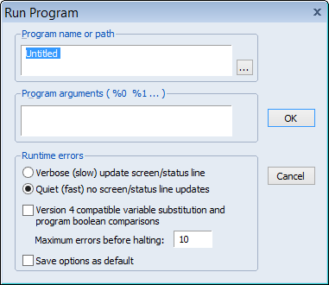
Maximum Number of Errors
By default, an EViews program will stop as soon as EViews issues an error. There are two methods available to override this behavior:
Use the Run dialog to increase the "Maximum errors before halting"
Use the setmaxerrs command within the program to dynamically change the number of errors allowed.

Slide 48
Maximum Number of Errors
Example:
wfcreate m 1990 2000
series y=@nrnd
series x=@nrnd
series w=@nrnd
series z=3
for %reg x z w
equation eq_{%reg}.ls y c {%reg}
next
This program loops through the series X, Z and W, performing a regression of Y against a constant and each of those series, one at a time. It will cause an error when it regresses against Z, since Z is perfectly collinear with the constant.

Slide 49
Maximum Number of Errors
Increasing the maximum number of errors to something greater than 1 in the Run dialog will let the program continue past the error.
Similarly, adding a setmaxerrs line to the program will allow it to run:
wfcreate m 1990 2000
series y=@nrnd
series x=@nrnd
series w=@nrnd
series z=3
setmaxerrs 100
for %reg x z w
equation eq_{%reg}.ls y c {%reg}
next

Slide 50
Program Execution

Slide 51
Running/Executing Programs
There are a number of ways to instruct EViews to run a program:
The Run button/dialog.
The Run command.
The Exec command.
The Include command.

Slide 52
Run Command
The Run command can be issued from the EViews command line to instruct EViews to open and run a program. The syntax is:
run myprogram.prg [arguments]
Simply give the name of the program (with a path, if required) following the Run command.
You may add arguments as a space delimited list following the name of the program.

Slide 53
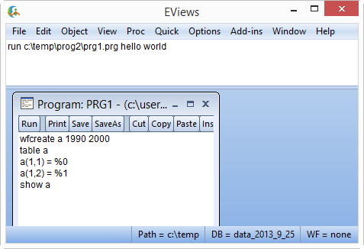
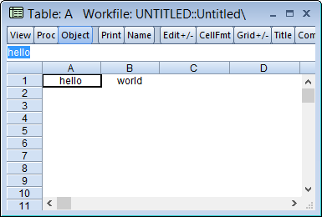
Run Command
For example:

Slide 54
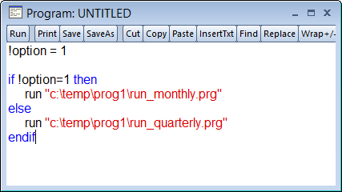
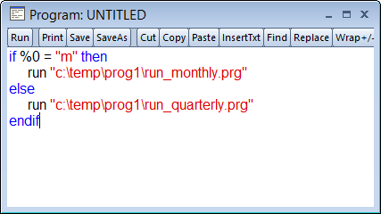
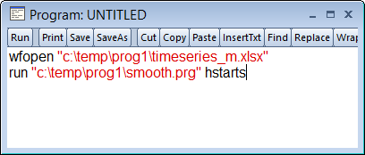
Run Command
You may also use the Run command inside a program to launch and run a second program.
For example:

Slide 55
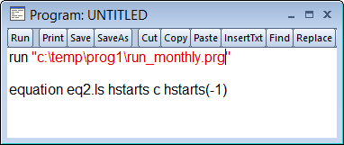
Run Command
However, the Run command has one drawback when being used inside a program: EViews will not return to the calling program once the child program has finished running. For example:
In this program the line estimating equation eq2 will never execute. EViews stops all program execution once run_monthly.prg has finished.

Slide 56
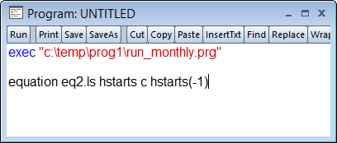
Exec Command
The Exec command works in the same was as the Run command, with one main differences; unlike the Run command, EViews will continuing executing the calling program after an Exec.
This program will execute the run_monthly.prg program, and then continue to execute the following lines, creating the equation eq2.

Slide 57
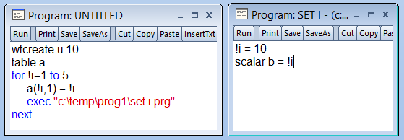
Exec Command
Note that with the Exec command (and Run) each program's program variables are isolated. i.e. setting a variable, such as !i, in the parent program will not interfere with a variable with the same name in the child program.
Similarly, any subroutines defined in the child program will not be available in the calling program.

Slide 58
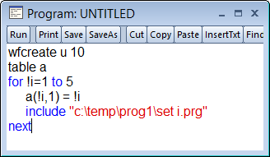
Include
The final way to execute a program from within a program is with the include command.
Include is similar to Exec with a couple of differences:
Unlike Exec, program variables are not isolated – the child program can interfere with program variables used in the parent
Subroutines are available to the parent program.

Slide 59
Tips
Run should never be used in a program
Include should only be used when loading a "library" of subroutines – the included program should not actually execute any code, merely provide subroutines for use in the parent program.
Exec should be used for all other times you wish to run a child program.

Slide 60
Subroutines

Slide 61
Subroutine Definition
EViews subroutines are user-defined functions that exist within the scope of the EViews programming language.
Subroutines allow you to define a set of commands in one part of your program and then call (or execute) those commands repeatedly in other parts of your program.
The basic syntax to define the start of a subroutine is to use the subroutine keyword, followed by the name of the subroutine. The subroutine ends with the endsub keyword.

Slide 62
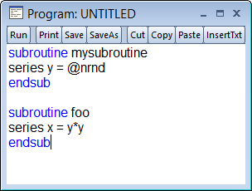
Subroutine Definition
Example:

Slide 63
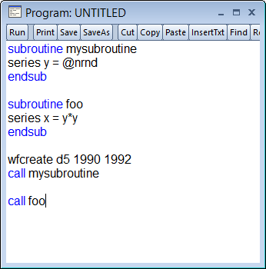
Calling Subroutines
To execute the code inside a subroutine, the call keyword is used, followed by the name of the subroutine you wish to execute.

Slide 64
Subroutine Arguments
Subroutines may include arguments, allowing you to define the variables used within the subroutine.
To declare arguments with your subroutine you define the type of object being passed in, as well as its name:
subroutine name(obj_type1 arg1, obj_type2 arg2, …)
The name of the arguments in your subroutine do not (and should not) be the name of objects in your workfile.

Slide 65
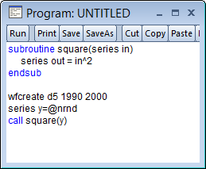
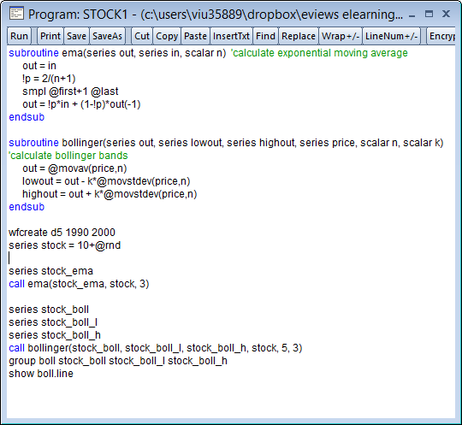
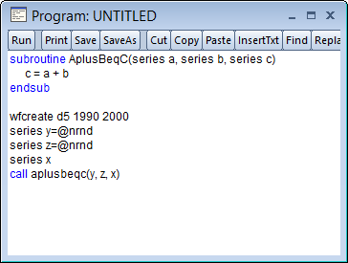
Subroutine Examples

Slide 66
Subroutine and Argument Placement
Subroutines can be placed anywhere in your program: at the start, at the end, or spread throughout the program. They need not be defined above the call statement that calls them.
Subroutine arguments can be inputs (i.e. objects that the subroutine uses) or outputs (i.e. objects that the subroutine produces), or both. There is no way to indicate that an object is an input or an output.

Slide 67
Tips
Subroutine should all be placed at the start of the program file for easy debugging access.
If you have many subroutines, define them in a separate program file and then include that file at the top of your program.
Define your subroutines such that outputs come first in the argument list (or come last). Don't mix inputs and outputs.
For even greater clarity, name the arguments with a name that indicates whether the argument is an input or output.

Slide 68
Subroutine Strings and Scalars
When defining a subroutine, you will often want to use a string or a scalar value as one of the arguments. You can choose whether to use a string/scalar workfile object, or a program variable as the argument:
subroutine foo(string a, scalar b)
subroutine goo(string %a, scalar !b)
Here foo uses workfile objects, and goo uses program variables (note the use of % and ! in the argument names).

Slide 69
Subroutine Strings and Scalars
When calling a subroutine with a string or scalar argument you can use a program variable, a workfile object, or a value, whether you defined the subroutine with or without a program variable.
subroutine foo(scalar b)
subroutine goo(scalar !b)
call foo(myscalar)
call foo(!x)
call foo(3)
call goo(myscalar)
call goo(!x)
call goo(3)

Slide 70
Subroutine Strings and Scalars
Thus there is very little difference between defining your subroutines with either objects or program variables when using strings or scalars.
The one exception is if the subroutine changes workfile page.
When using a workfile object as an argument, changing the workfile page means that the object is no longer available inside the subroutine.

Slide 71
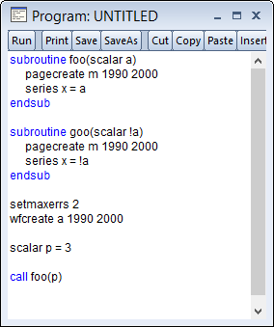
Subroutine Strings and Scalars
For example the following program will error inside foo because the scalar a is not available on the new page, so x cannot be created.
Using goo instead will work just fine.

Slide 72
User Dialogs

Slide 73
User Dialogs
EViews provides a number of functions for the creation of custom dialogs inside an EViews program.
These custom dialogs (or User Dialogs to use the EViews term) allow the program to present information, or collect information, from the person running the program.
They provide a more elegant way of providing program input options than program arguments, program options, or simply letting the user configure some settings at the top of the program.

Slide 74
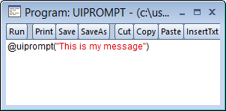
User Dialogs
The simplest form of User Dialog is the @uiprompt("msg") function.
It simply produces a message box for the user containing the message msg:

Slide 75
User Dialogs
Other simple User Dialogs functions:
The iostring or ioscalar arguments are both an input and output. They decide what is pre-filled in in the dialog, and they return the user's input to the dialog.
Function | Description | Full Syntax
@uiedit | Produces an edit field. | @uiedit(string iostring, string prompt)
@uilist | Produces a list box. Has two versions, one returns a string, the other a scalar. | @uilist(string iostring, string prompt, string list) @uilist(scalar ioscalar, string prompt, string list)
@uiradio | Produces a set of radio buttons. | @uiradio(scalar ioscalar, string prompt, string list)

Slide 76
User Dialogs
All User Dialogs are EViews functions, and as such have return values. The value returned depends upon whether the user clicked on the "OK" button or the "Cancel" button.
If a user clicks "OK" on the User Dialog, the function will return a value of 0. "Cancel" returns -1.

Slide 77
@uidialog
The final User Dialog function is @uidialog, and it is the most complicated, allowing you to build extensive dialogs with many different controls inside them.
To specify a dialog with @uidialog, you must enter a list of control types and the arguments for each control type.

Slide 78
@uidialog
The controls are:
@uidialog also returns a 0 or -1 depending on whether "OK" or "Cancel" was pressed, unless there is a custom button control, in which case pressing the button rather than "OK" or "Cancel" will return a positive integer.
Control | Arguments | Description
"edit" | string iostring, string prompt | Edit box
"list" | string iostring, string prompt, string list scalar ioscalar, string prompt, string list | List box
"radio" | scalar ioscalar, string prompt, string list | Set of radio buttons
"check" | scalar ioscalar, string prompt | Single check box
"caption" | string caption | Dialog title
"button" | string buttontext | Custom button

Slide 79
EViews Add-ins

Slide 80
EViews Add-ins
EViews Add-ins are ways of extending the features available in EViews via the menu system, or via the command language.
A number of Add-ins are available to download by clicking on the Add-ins menu.
However, the most important thing about Add-ins (at least for this class) is that Add-ins are really nothing more than EViews programs.
Any program you write can be turned into an EViews Add-in, simply by using the Manage Add-ins menu item.

Slide 81
Adding Add-ins
When you add an Add-in to your copy of EViews, you may specify whether the Add-in is available via the menu system, via a command, or both.
You may also choose whether to make your Add-in Global or Object-specific.
Global add-ins are available at all times, and always appear in the Add-ins menu. Object-specific add-ins only appear in the Add-ins menu when an object of that type is open.

Slide 82
addin
Rather than using the menu system to register/add an Add-in, you may add one via the addin command. The syntax is:
addin(type=type, docs=docspath, menu=menutext, proc=proctext) programname
(There are other options also available – see the Command Reference entry for more details).
Type should be the object type of the Add-in, or "Global" for a Global Add-in.
Docspath should be the full path and file name of any documentation accompanying the Add-in.
Menutext should be the text to add to the Add-ins menu (if any).
Proctext should be the command line given to the Add-in.

Slide 83
_this
Object-specific Add-ins work on whatever object is currently open. An equation-specific Add-in might, for example, use the coefficient covariance matrix to perform a post-estimation diagnostic.
The problem is that you probably won't know the name of the currently open object, so referencing the data-members, or accessing views and procs of the currently open object could be tricky.

Slide 84
_this
Thankfully, EViews provides the _this keyword. _this simply tells EViews that you want to work with the current open object.
All of the object data members, procs and views are available by using _this rather than the object's name.
Thus:
_this.hist will show a histogram of the current open object (if the current open object is a series).
_this.@coefcov will access the equation's coefficient covariance matrix (if the current open object is an equation).

